Slide 1
BITS Pilani presentation
K.Anantharaman
kanantharaman@wilp.bits-pilani.ac.in
18/03/23
SE ZG544 S1-23-24 Agile Software Process

Slide 2
SE CZ 544 , Agile Software Process
Module – 7
Sprint Planning
18/03/23
SE ZG544 S1-23-24 Agile Software Process

Slide 3
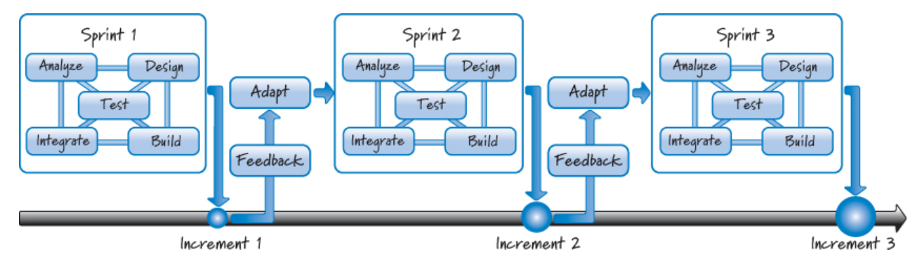
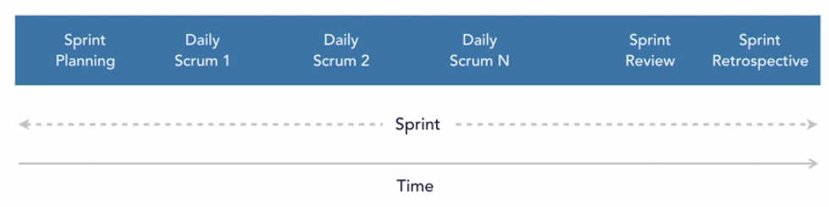
Sprint Overview
Scrum Events:
Time Boxed
Typical sprint length = 2weeks
Planning = 2 hrs.
Review = 2 hrs.
Retro = 1.5 hrs.
Every Sprint is a learning Opportunity
Constructivism - Approach
Ref: Essential Scrum: A Practical Guide to the Most Popular Agile Process by Kenneth S. Rubin Published by Addison-Wesley Professional, 2012
18/03/23
SE ZG544 S1-23-24 Agile Software Process

Slide 4
Inputs for Iteration Planning
Product backlog—with enough ready stories for about two iterations- Prioritized
Quarterly (release) roadmap
Definition of ready (DoR), where used; definition of done (DoD)
Past performance (velocity), if available
Availability of team members during the upcoming iteration (Capacity Planning)
Process improvement tasks—added to the iteration backlog during the last iteration retrospective
18/03/23
SE ZG544 S1-23-24 Agile Software Process

Slide 5
Outputs of Iteration Planning
Planning Part1
Sprint goal
Discuss Stories
Negotiate, Forecast/Identify stories
Planning Part2
Identify developer tasks
Sign up for tasks
Estimate tasks
Negotiation
Commitment
Task Board
Capacity = Velocity ± Changed Circumstances
Capacity = Total Potential Person-Days × Availability − Slack
18/03/23
SE ZG544 S1-23-24 Agile Software Process

Slide 6
Definition of ‘Done”
Completion Criteria – Defined by Development Team
Code Complete and Checked in
Unit test done
Peer reviewed
QA Compete
Documentation done
Acceptance criteria – Defined by Product owner
PO determines when the acceptance criteria s done
At this point, the story is considered accepted or “DONE”
21/1023
SE ZG544 S1-23-24 Agile Software Process

Slide 7
Quiz
https://forms.gle/UChV4y1fLnjfvBJ57
https://forms.gle/aG5AcsK5CcPrARAXA
https://forms.gle/aG5AcsK5CcPrARAXA
https://forms.gle/ZuQG7Fw6Sp8y6YsFA

Slide 8
Sprint Planning – Additional Notes
18/03/23
SE ZG544 S1-23-24 Agile Software Process

Slide 9

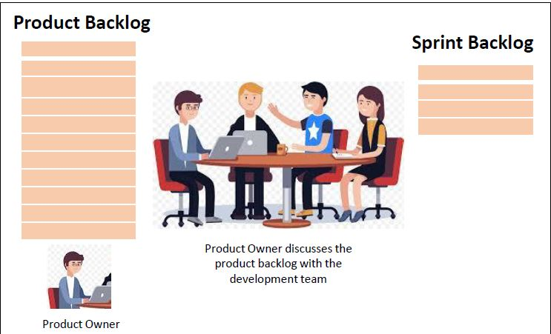
Sprint planning
Sprint planning happens once in each Sprint
Entire Scrum Team: Product Owner, Scrum Master & Development Team must be a part of the event
Time box for the event is 8 hours (upper limit)
Two agendas
What is to be done in this Sprint-Part1
Establish how it will be done-Part2
What is to be done?
Sprint Goal/Objectives
Responsibility: PO and Team
How it will be done?
The team pulls subset of stories from Product backlog
Spilt into Engineering tasks and estimates.
Check against team velocity/capacity, Refine goal.
The team Plan is not fixed, it evolves as more clarity increases
Development team will come up with the plan
18/03/23
SE ZG544 S1-23-24 Agile Software Process
Source: GenMan Solutions

Slide 10
Sprint Planning Artifacts
There are two defined artifacts that result from a sprint planning meeting:
A sprint goal
A sprint backlog
A sprint goal is a short, one- or two-sentence, description of what the team plans to achieve during the sprint. It is written collaboratively by the team and the product owner.
The following are example sprint goals on an eCommerce application:
Implement basic shopping cart functionality including add, remove, and update quantities.
Develop the checkout process: pay for an order, pick shipping, order gift wrapping, etc.
18/03/23
SE ZG544 S1-23-24 Agile Software Process

Slide 11
Examples of Sprint goals
“Demonstrate the ability to send a text message through an integrated software, firmware, and hardware stack.”
“Update mobile apps for faster convenient check-in for our valued customers”
“Learn about the right user interaction” for the registration feature” (Learning goal, Risk Reduction)
A non-optimal example of sprint goal is:
Implement all user stories to meet the definition of done, and fix all defects selected for this sprint. This sprint goal is too generic to be of any value in limiting the scope of work, and cannot inspire the team.
18/03/23
SE ZG544 S1-23-24 Agile Software Process

Slide 12
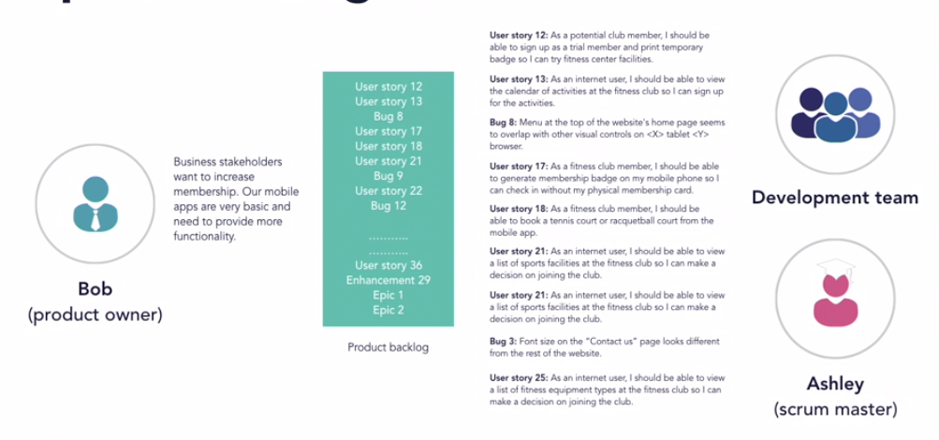
Sprint Planning : Part-1 – Defining the Sprint Goal - The Process
3.Dev. team pulls** subset of these stories from top of the product backlog and asks clarifications.
** Velocity, Team Capacity,Prority
Spike, Bugs ,Infra included
Refine Sprint goal and agree
1. Product owner starts first with this kind of information
2. Product owner shows the Prioritized product backlog with this goal in mind – High value story at the top.
Ref: LinkedIn Learning - Agile Software Development: Scrum for Developers with Shashi Shekhar.
18/03/23
SE ZG544 S1-23-24 Agile Software Process

Slide 13
Sprint Planning – Part-2 –
The How
Part-2 of the sprint planning is owned by the Development team.
The Dev. Team focuses on detailed planning – splitting user stories into engineering/programming tasks.
Tasks are estimated in Ideal hours.
Product owner and Scrum master are available to facilitate and answer any questions.
18/03/23
SE ZG544 S1-23-24 Agile Software Process

Slide 14
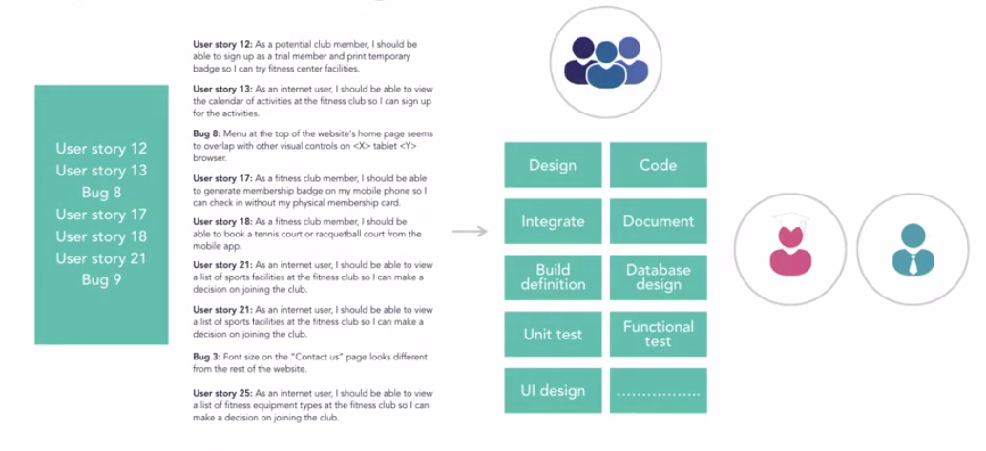
Sprint Planning – Part-2 –
Splitting into fine grain tasks
Note: This is not an elaborate plan for the entire sprint. This is just a collection of tasks for the next few days. More planning will be done by the development team as they finish tasks and learn more about the tasks at hand.- em-pir-i-cism, Last responsible moment.
Tasks are not assigned to the team by PO or SM. Pulled by dev. Team.
Ref: LinkedIn Learning - Agile Software Development: Scrum for Developers with Shashi Shekhar.
18/03/23
SE ZG544 S1-23-24 Agile Software Process

Slide 15
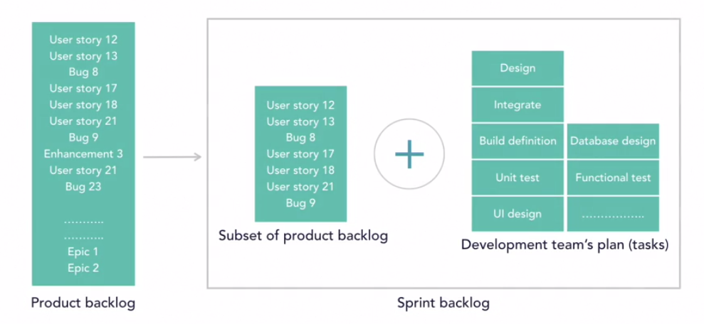
The Sprint Planning Ends with Sprint Backlog + Team Commitment + Refined Sprint Goal
Most Team break all user stories pulled for the sprint into tasks and estimate in ideal hours. Then compare with team capacity to establish confidence
Sprint Goal
Ref: LinkedIn Learning - Agile Software Development: Scrum for Developers with Shashi Shekhar.
Ref: LinkedIn Learning - Agile Software Development: Scrum for Developers with Shashi Shekhar.
18/03/23
SE ZG544 S1-23-24 Agile Software Process

Slide 16
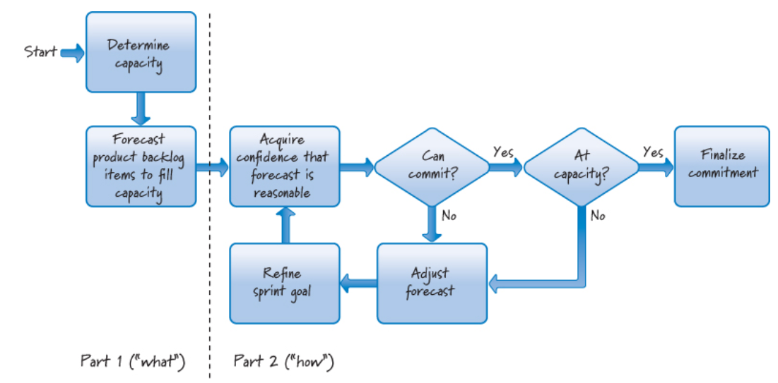
The Process flow
Team Capacity = Mean Velocity (or) Team Available Hours
Team Available Hours = Sum of available hours of each team member – Sprint Contingency buffer
Available hours of each member = Actual hours minus (Personal leave, Meetings, Public Holidays)
Initial Sprint Goal
Ref: Essential Scrum: A Practical Guide to the Most Popular Agile Process by Kenneth S. Rubin Published by Addison-Wesley Professional, 2012
18/03/23
SE ZG544 S1-23-24 Agile Software Process

Slide 17
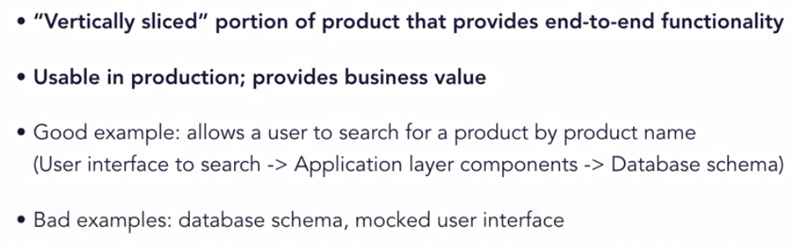
Potentially Shippable Product Increment (PSI)
Each sprint must end with a potentially shippable increment.
Product owner decides when to release the increment to user community (immediately or later).
The product increment needs to be:
18/03/23
SE ZG544 S1-23-24 Agile Software Process

Slide 18
Sprint Practices
Sprint 0:
Some team just focuses on planning/design and does not produce a working product increment. Sprint zero. - Not a Good Practice
Instead combine planning with some functionality delivery. – Good practice.
Hardening Sprint:
Hardening sprints are designated for stabilizing products by fixing quality and performance issues.
The problem with this approach is that it encourages teams to produce unstable products at the end of sprints that do not provide expected business value and reduce transparency about a team's progress status, - Not a Good practice
18/03/23
SE ZG544 S1-23-24 Agile Software Process

Slide 19
Spike - Story
Spikes are research activities that are sometimes performed by Scrum teams.
For example, evaluating a set of products/Technical solution to find the best solution for a specific business need.
Spikes are allowed in Scrum but the golden rule is to combine spike activities with other development activities,
Avoid sprints compromised entirely of spikes- Good Practice
This is the era of continuous delivery where organizations release features multiple times during the day – This practice is acceptable within Sprint
18/03/23
SE ZG544 S1-23-24 Agile Software Process

Slide 20
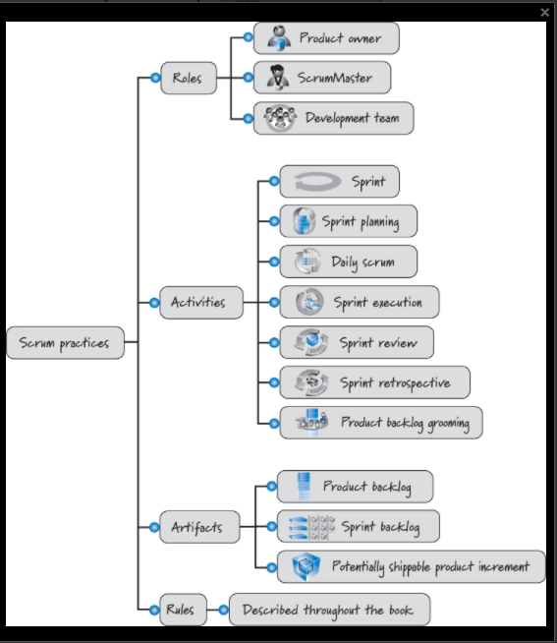
Scrum Practices
Ref: Essential Scrum: A Practical Guide to the Most Popular Agile Process by Kenneth S. Rubin Published by Addison-Wesley Professional, 2012
18/03/23
SE ZG544 S1-23-24 Agile Software Process

Slide 21
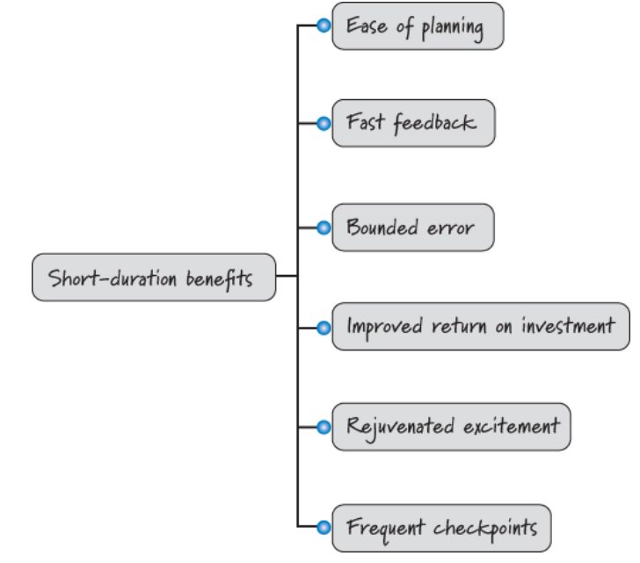
Short Sprints
Ref: Essential Scrum: A Practical Guide to the Most Popular Agile Process by Kenneth S. Rubin Published by Addison-Wesley Professional, 2012
18/03/23
SE ZG544 S1-23-24 Agile Software Process

Slide 22
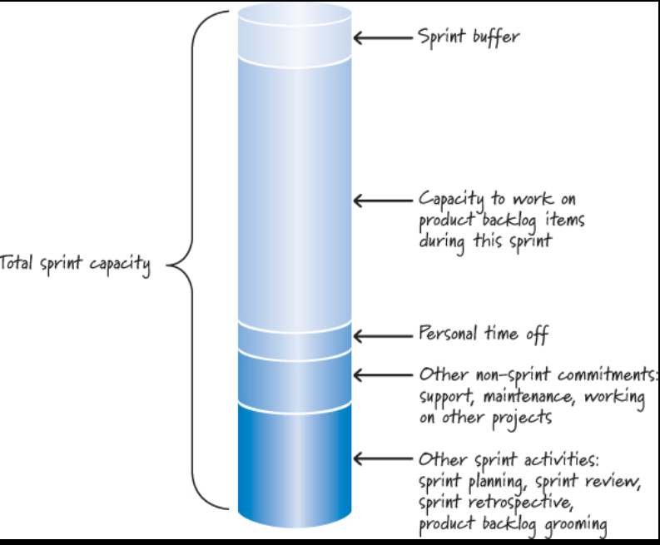
Development team capacity in a sprint
Ref: Essential Scrum: A Practical Guide to the Most Popular Agile Process by Kenneth S. Rubin Published by Addison-Wesley Professional, 2012
18/03/23
SE ZG544 S1-23-24 Agile Software Process

Slide 23
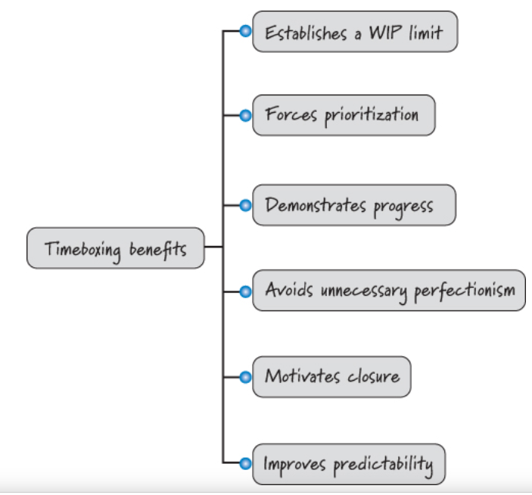
Time Boxing
18/03/23
SE ZG544 S1-23-24 Agile Software Process

Slide 24
Capacity in Story Points
Initial estimate of its capacity/velocity for the upcoming sprint:
Start with the team’s long-term average velocity.
Sometimes referred to as the “yesterday’s weather” approach.
Example:
Suppose Average Velocity = 40 Story points for 2 weeks sprint
Consider whether the upcoming sprint might differ from typical or previous sprints (it might not).
The result is a reasonable adjusted capacity (predicted velocity) for the upcoming sprint.
Adjust the velocity if the sprint is planned during long holidays (Year end holidays).
18/03/23
SE ZG544 S1-23-24 Agile Software Process

Slide 25
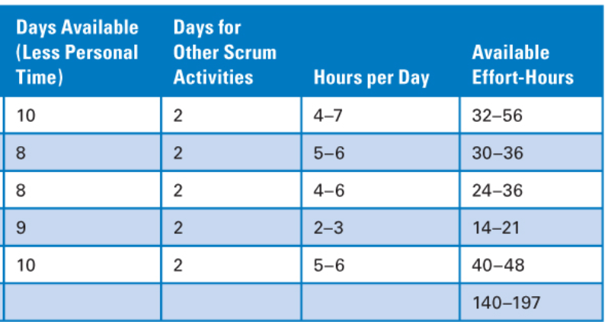
Capacity in Effort- Hours
(Two Weeks Sprint) - Example
Team Members
1
2
3
4
5
Caution: Taking 197 hours of work because it would leave no sprint buffer.
Better strategy: > 140 hrs. and < 197 hrs.
If all team members are available full time and no personal holidays – Capacity = (Available Capacity) – (Total Days for Scrum activities ) – Sprint buffer (Assume 5%)
= 400 – 80 – 20 = 300 hours – plan for 320-300 hours of capacity
Ref: Essential Scrum: A Practical Guide to the Most Popular Agile Process by Kenneth S. Rubin Published by Addison-Wesley Professional, 2012
18/03/23
SE ZG544 S1-23-24 Agile Software Process

Slide 26
Selecting Product Backlog Items
If we have a sprint goal, we would select product backlog items that align with that goal.
If there is no formal sprint goal, our default is to select items from the top of the product backlog. We would start with the topmost item and then move to the next item and so forth.
If the team were not able to commit to the next-highest-priority item (perhaps there is a skills capacity issue), it would select the next appropriate higher-priority backlog item that looks as if it can be completed within the constraints.
Also, having a good definition of ready will prevent product backlog items from being selected that are poorly defined or have unfulfilled resource or dependency constraints that would prevent our finishing them in a sprint.
The start-only-what-you-can-finish rule is based on the principles that we should limit WIP and that starting something and not finishing it generates a variety of forms of waste.
18/03/23
SE ZG544 S1-23-24 Agile Software Process

Slide 27
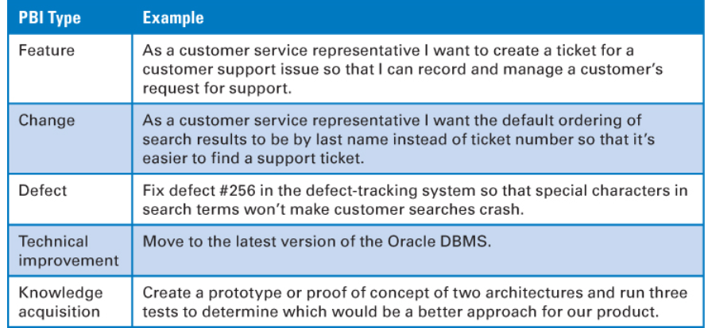
Examples of Product Backlog Items (PBI)
Ref: Essential Scrum: A Practical Guide to the Most Popular Agile Process by Kenneth S. Rubin Published by Addison-Wesley Professional, 2012
18/03/23
SE ZG544 S1-23-24 Agile Software Process

Slide 28
Acquiring Confidence
Use predicted velocity to see if the commitment is realistic.
If predicted sprint velocity is 25 story points and our team has selected 45 story points’ worth of work, the team should be concerned.
The risk of using velocity as the sole means of establishing confidence is that even though the numbers look right, the commitment might still be unachievable.
However, until we dig a little deeper to the task level, we don’t really know if the set of product backlog items that total 21 story points can actually be completed—there could be dependency issues, skills capacity issues, as well as a host of other issues that make it impractical for the team to get them all done.
18/03/23
SE ZG544 S1-23-24 Agile Software Process

Slide 29
Acquiring Confidence …
Most Scrum teams gain the necessary level of confidence by breaking the product backlog items down into the tasks that are required to complete them to the Scrum team’s agreed-upon definition of done.
These tasks can then be estimated (usually in effort-Ideal hours) and subtracted from the team’s capacity.
Breaking product backlog items into tasks is a form of design and just-in-time planning for how to get the items done.
The result is a sprint backlog
18/03/23
SE ZG544 S1-23-24 Agile Software Process

Slide 30
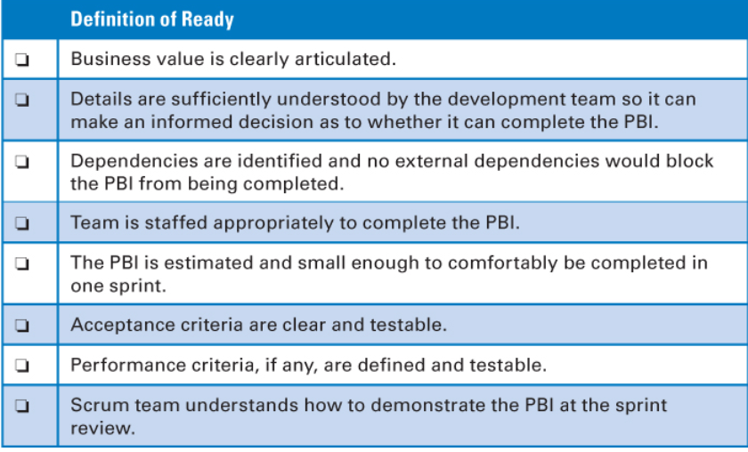
Definition of Ready
You can think of the definition of ready and the definition of done as two states of product backlog items during a sprint cycle.
State-1 : Before the start Sprint planning
State-2: After the item considered as done
Example: Definition of ready
Ref: Essential Scrum: A Practical Guide to the Most Popular Agile Process by Kenneth S. Rubin Published by Addison-Wesley Professional, 2012
18/03/23
SE ZG544 S1-23-24 Agile Software Process

Slide 31
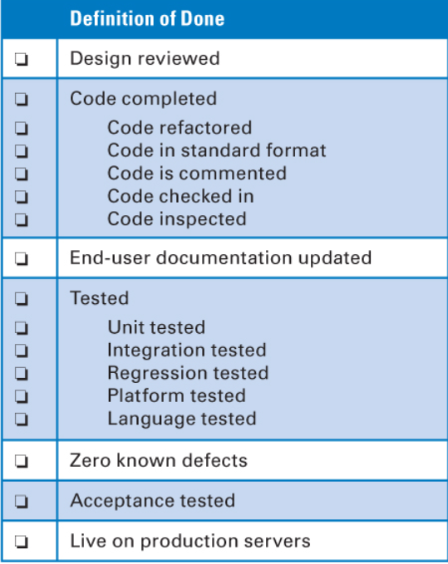
Definition of Done
Conceptually the definition of done is a checklist of the types of work that the team is expected to successfully complete before it can declare its work to be potentially shippable.
Can be applied to product backlog item, Increment or a release.
Obviously the specific items on the checklist will depend on a number of variables:
The nature of the product being built
The technologies being used to build it
The organization that is building it
The current impediments that affect what is possible
Definition of Done Can Evolve Over Time
An Example
Ref: Essential Scrum: A Practical Guide to the Most Popular Agile Process by Kenneth S. Rubin Published by Addison-Wesley Professional, 2012
18/03/23
SE ZG544 S1-23-24 Agile Software Process

Slide 32
Definition of Done …
Most of the time, a bare-minimum definition of done should yield a complete slice of product functionality, one that has been designed, built, integrated, tested, and documented and would deliver validated customer value.
To have a useful checklist, however, these larger-level work items need to be further refined.
For example, what does tested mean? Unit tested? Integration tested? System tested? Platform tested? Internationalization tested? You can probably think of many other forms of testing that are specific to your product. Are all of those types of testing included in the definition of done?
Scrum teams need to have a robust definition of done, one that provides a high level of confidence that what they build is of high quality and can be shipped. Anything less robs the organization of the business opportunity of shipping at its discretion and can lead to the accrual of technical debt
18/03/23
SE ZG544 S1-23-24 Agile Software Process

Slide 33
Thank you
18/03/23
SE ZG544 S1-23-24 Agile Software Process

